Slide 1
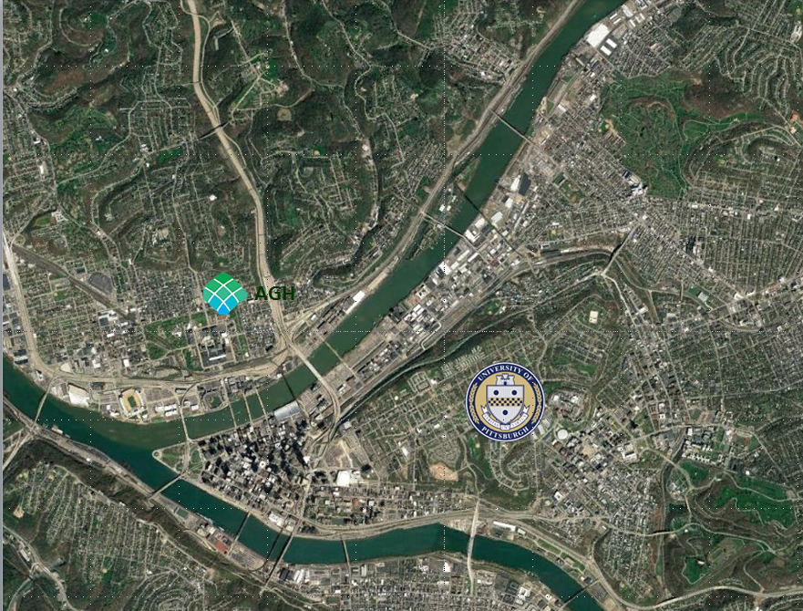
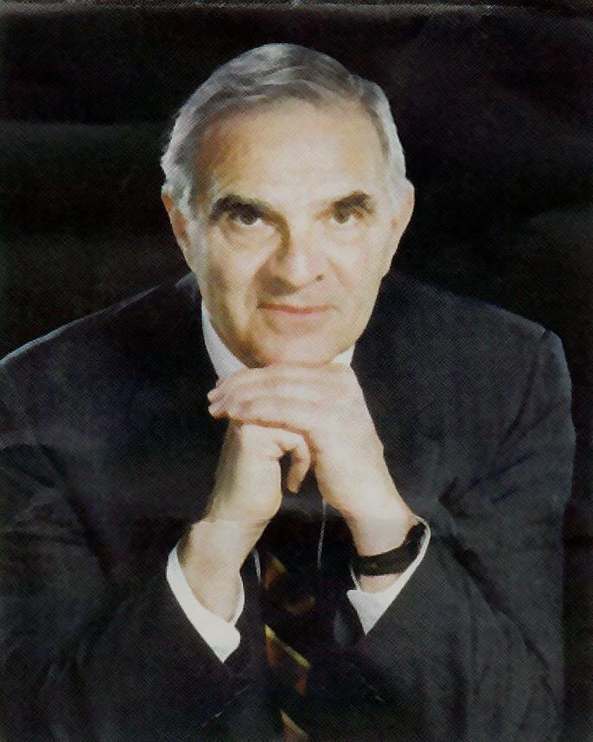
Tribute to Peter Jannetta by Stephen J. Haines at the 2017 Annual Meeting of the Neurosurgical Society of America
Peter J. Jannetta: In Memorium

Slide 2
It is my pleasure and awesome responsibility to lead us in remembering a giant of Neurosurgery, valued member of this Society, mentor and friend, Peter J. Jannetta, denizen of Pittsburgh, King of the Cranial Nerves.

Slide 3
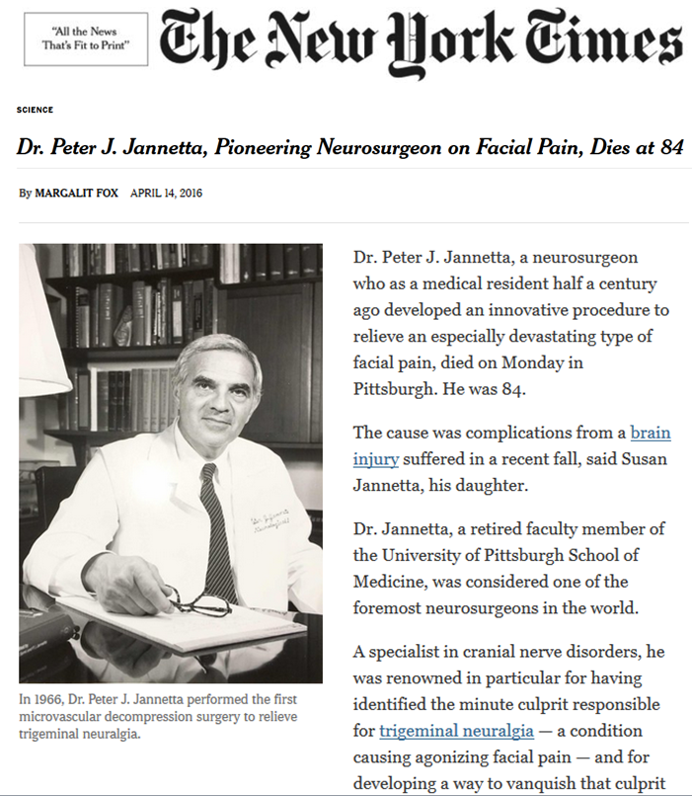
Peter Joseph Jannetta would have been an international superstar in whatever endeavor he chose to pursue. We are very fortunate that he chose neurosurgery. The usual details of his life are readily available in the formal obituaries published in the New York Times

Slide 4
and the Pittsburgh Post Gazette.

Slide 5
Philadelphia 1932 – 2016 Pittsburgh
the details
AB, MD, Neurophysiology Fellow, Surgery Resident: University of Pennsylvania, 1958 - 63
Neurosurgery Resident, UCLA, 1963 – 66
Chairman, Neurosurgery, LSU, 1966 – 1971
Chairman, Neurological Surgery, University of Pittsburgh, 1971 – 1997
Professor of Neurological Surgery, University of Pittsburgh, 1997 – 2000
Professor of Neurosurgery, Allegheny General Hospital (Drexel University), 2000 - 2016

Slide 6
But you can read that stuff. This was not a conventional neurosurgeon. Among his unusual accomplishments he was elected to the Horatio Alger Society in 1990. The only other neurosurgeon we know in the Society is Ben Carson. He became acquainted with the poet Maya Angelou through this society..

Slide 7
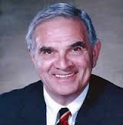
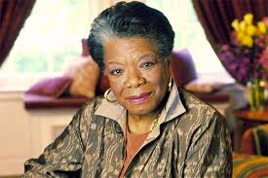
Things Neurosurgeons Don’t Usually Do
Horatio Alger Award, 1990

Slide 8
Note that Peter and Maya are Awake
Horatio Alger Award, 1990

Slide 9
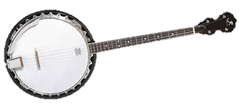
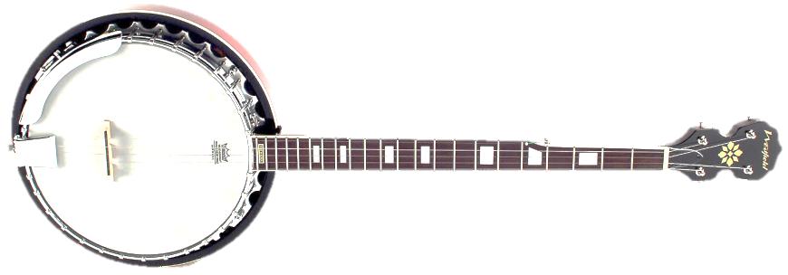
Things Neurosurgeons Don’t Usually Do
He was Secretary of Health for the State of Pennsylvania in 1995
And he played the banjo.
Note this is a 4 string tenor banjo – his choice. This was another point of similarity and contention between us. I much prefer the 5-string banjo.

Slide 10
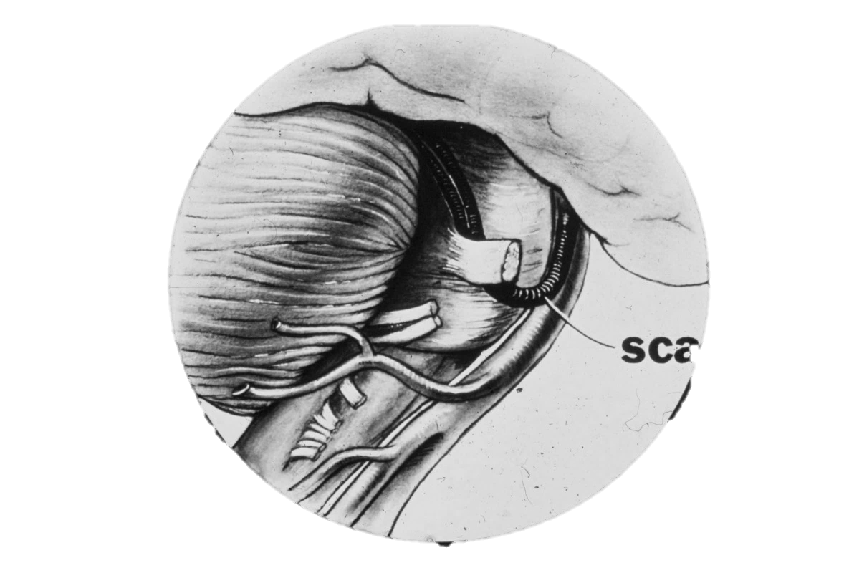
He will forever be known for his seminal contribution in identifying the classic lesion causing most cases of what was once known as idiopathic trigeminal neuralgia and hemifacial spasm.

Slide 11
That would have been enough for most of us, but not for Peter…
The bigger concept, that any cranial nerve, and perhaps other parts of the brainstem, were susceptible to vascular compression and could produce recognizable clinical syndromes occupied the rest of his life.
He recognized the audaciousness of the concept and compared it to opening Pandora’s box.

Slide 12
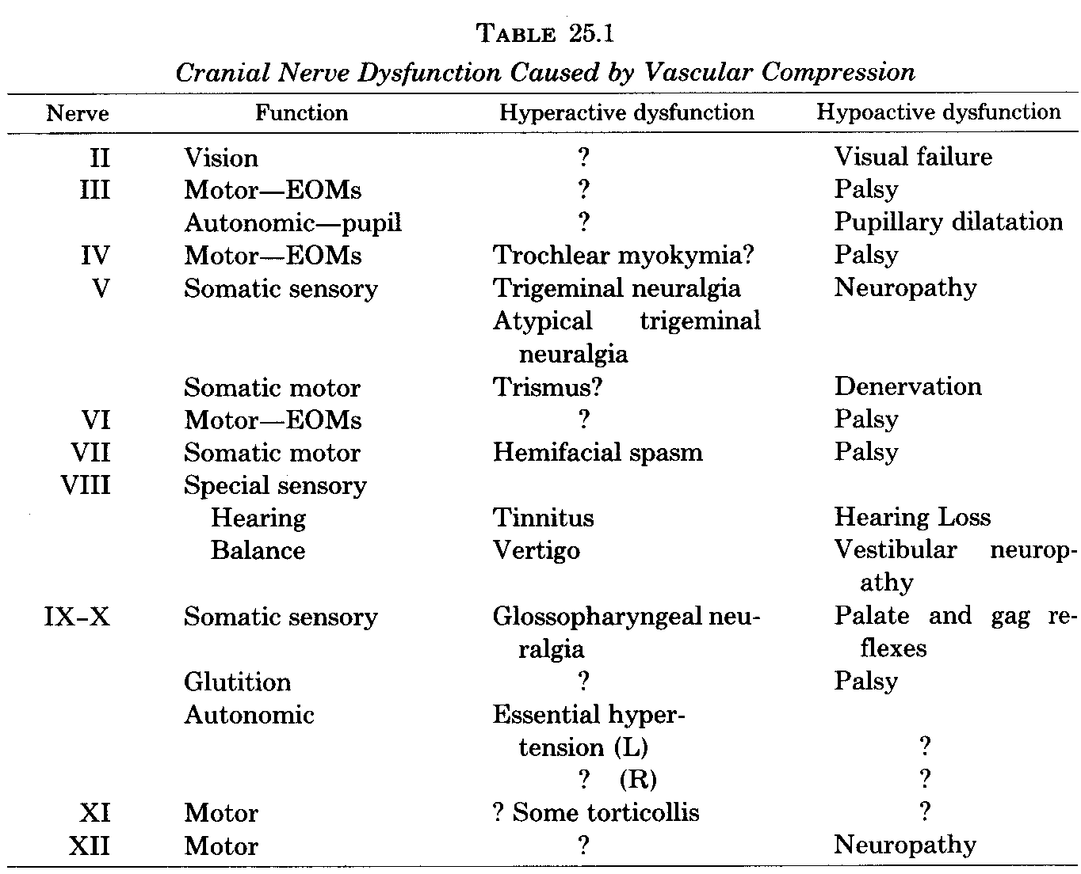
Opening Pandora’s Box
Clinical Neurosurgery 1980; 28:446

Slide 13
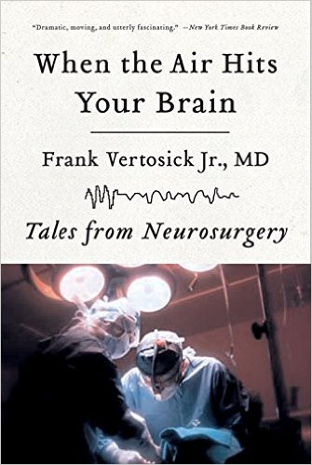
“the chiropractor of the cranial nerves”
Which earned him the label “chiropractor of the cranial nerves” from Frank Vertosek, a 1988 graduate of the Pittsburgh residency and author of “When the Air Hits Your Brain”.

Slide 14
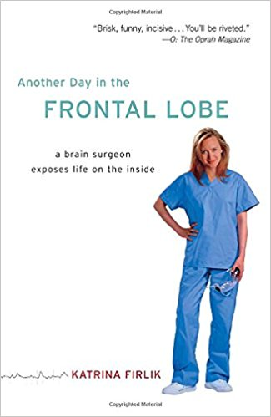
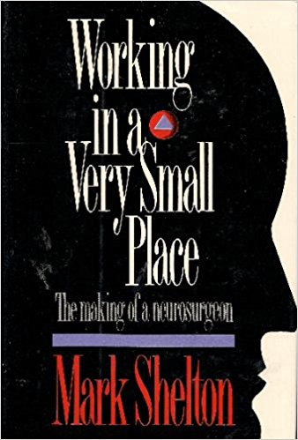
Which brings me to real genius of Peter Jannetta. He fostered the careers of an immensely diverse group of experts skilled in a variety of non-neurosurgical endeavors.
We start with the popular literature the grew up around him.
Here is another popular book by a former resident, Katrina Firlik.
And the book by Mark Shelton, not a former resident, that tells a version of the trigeminal neuralgia story.

Slide 15
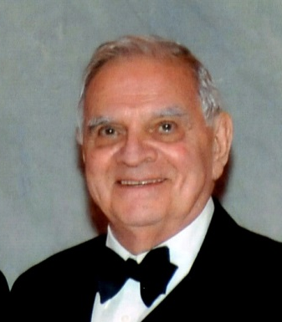
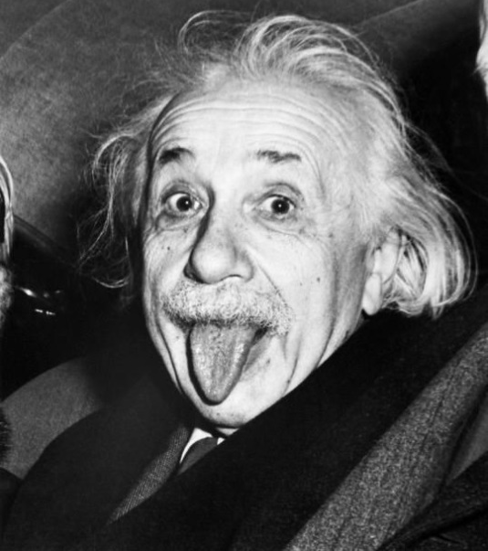
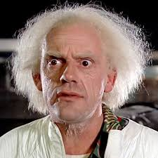
The Genius of Peter Jannetta
Genius has many faces and personalities. Peter’s real genius was to recognize the possibilities of new ideas, to celebrate the disruption they produce and encourage their development for the progress and improvement of patient care through neurosurgery.

Slide 16
The Genius of Peter Jannetta
Support growth driven by passion
Encourage provocative innovation under a big tent
He was the ringmaster in a very big tent in which he supported the growth of new conflicting ideas. His ability not just to tolerate conflicting points of view but to encourage them led to the development of one of the world’s most fertile schools of neurosurgery.

Slide 17
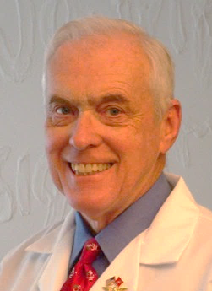
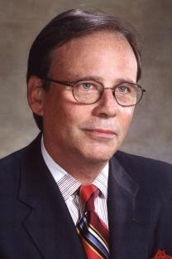
Productive Conflict in PJ’s School of Neurosurgery
Chuck Kerber
endovascular
Roberto Heros
open vascular
Dade Lunsford
Percutaneous
Trigeminal
neuralgia
Peter Jannetta
Open
Trigeminal
neuralgia

Slide 18
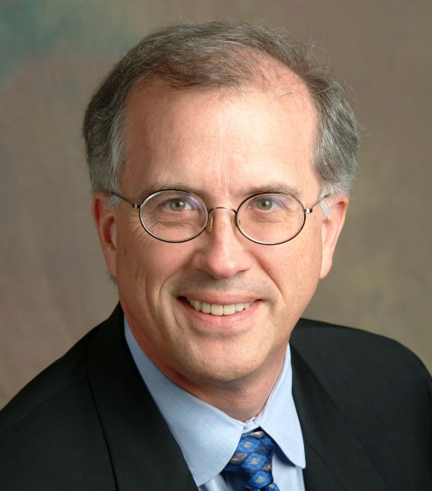
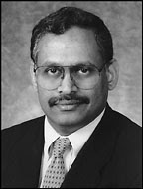
Productive Conflict in PJ’s School of Neurosurgery
Peter Jannetta
Intuition-based
neurosurgery
Stephen Haines
evidence-based
neurosurgery
Laligam Sekhar
Skull base
surgery
Peter Jannetta
Skull base
surgery

Slide 19
Productive Conflict in PJ’s School of Neurosurgery
Dade Lunsford
Gamma Knife
Skull base
surgery
Laligam Sekhar
open
Skull base
surgery
“cacophany of serendipity”

Slide 20
“cacophany of serendipity”
The term “cacophany of serendipity” has been used to describe some views of evolutionary theory (Cornelius Hunter author of Darwin’s God) and the 1944 St. Louis Browns baseball season (Steven Goldman, It Ain’t Over ‘Till It’s Over) but describes Jannetta’s School of Neurosurgery very well.

Slide 21
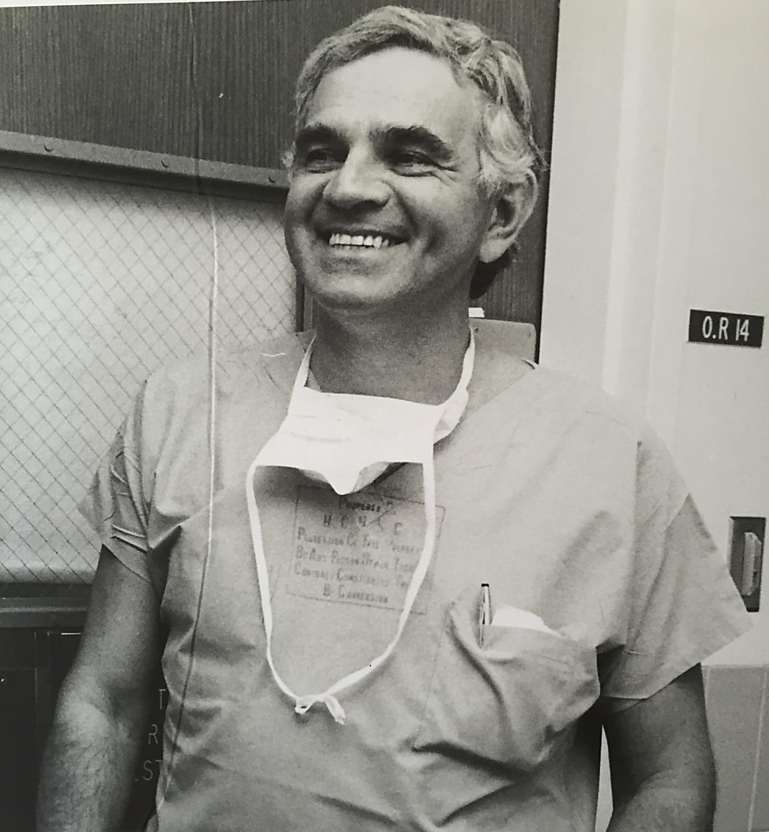
This is the Peter Jannetta I remember best
The pure joy of operating.
He would hum in your ear.

Slide 22
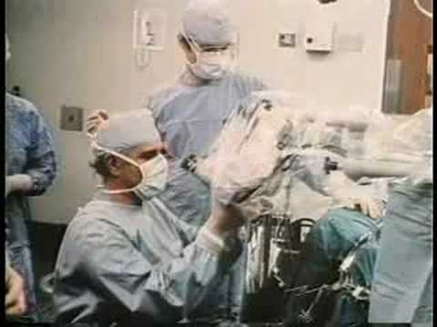
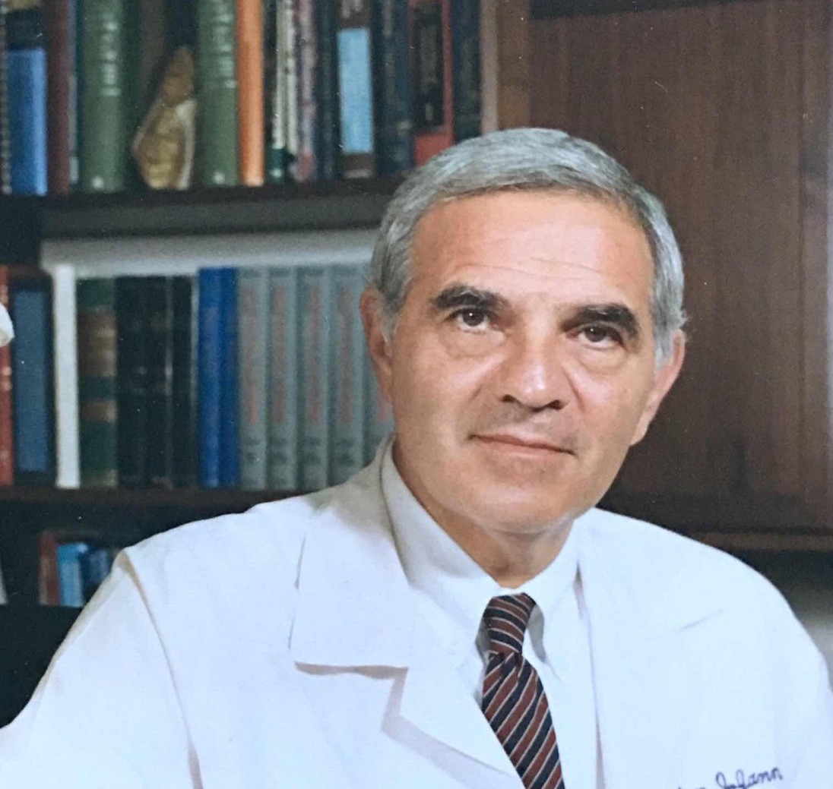
Early in residency he would walk into the OR about 20 minutes into the operation to find you completing the opening and ask “same case?”
The best day in a resident’s life was the day he walked into the operating room, looked through the microscope and said “I’ve made myself redundant”

Slide 23
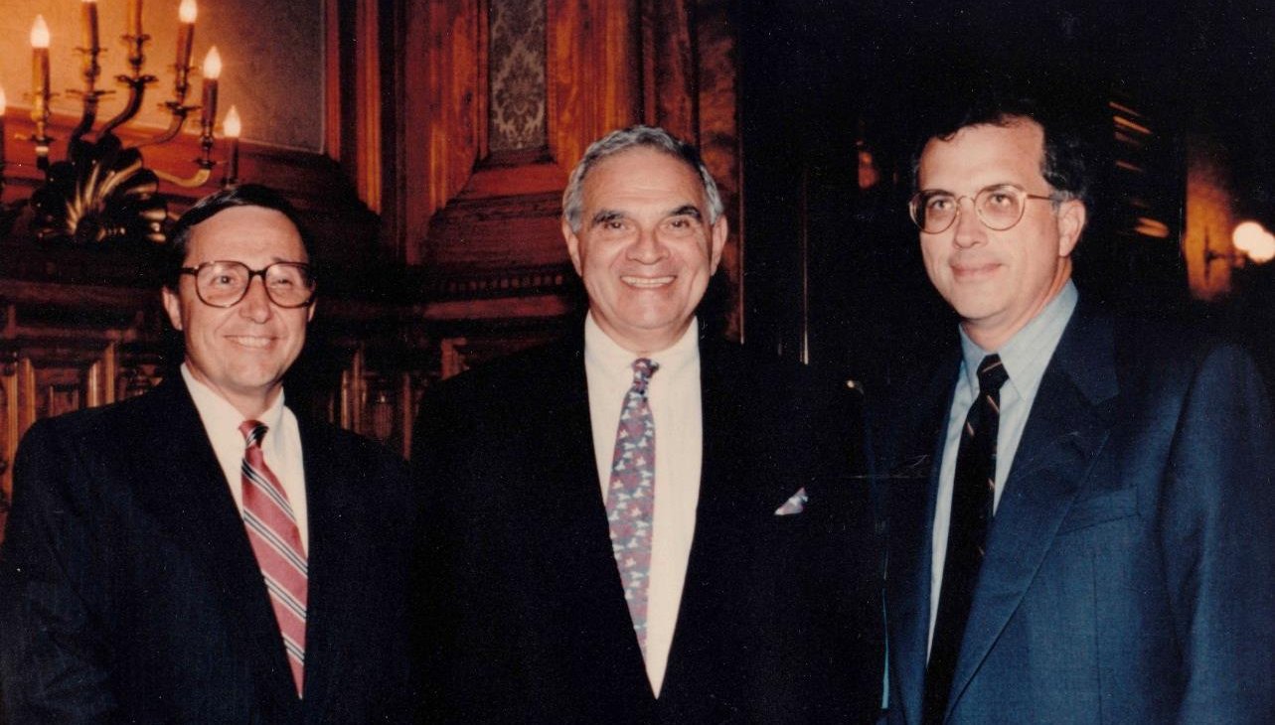
Here he is with former NSA President Paul Nelson and with me at the Honored Guest dinner of the 1996 Congress meeting.

Slide 24
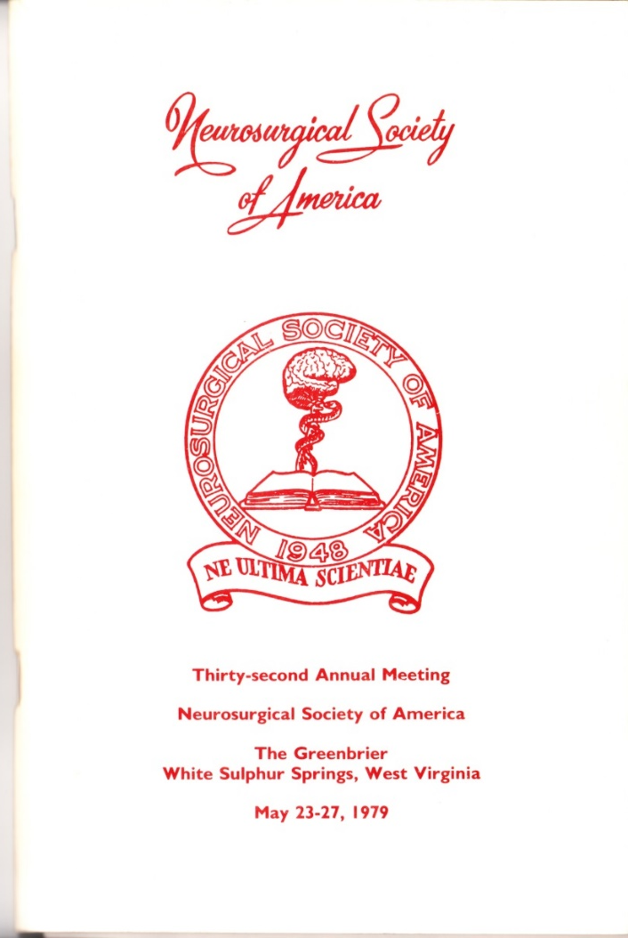
He sponsored both of us at our first NSA meeting in 1979.
Having him serve as the Honored Guest of the Congress was an extraordinary opportunity to be able to partially repay his mentorship.

Slide 25
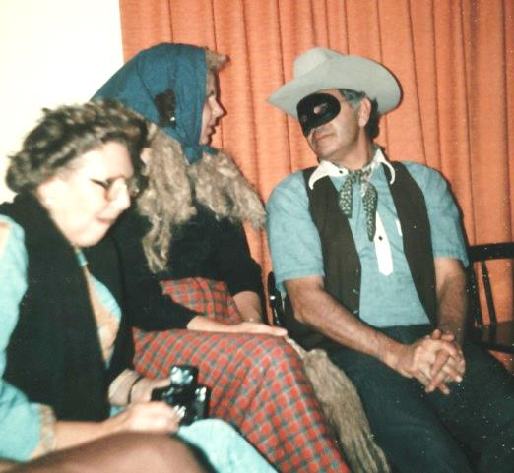
He had a great and subtle sense of humor. We gave a Hallowe’en costume party at our home during residency. It was during the years leading up to his divorce. It wasn’t widely known, at least among the residents, that there were problems. He came as the Lone Ranger.

Slide 26
The “Lone” in the Ranger ended with his marriage to Diana. She changed his life, made him a collector of art and supported him through the sometimes choppy waters of his later years.
The beautiful home they created was indeed a museum but also a warm, comfortable place where I was honored to stay the year before he died.

Slide 27
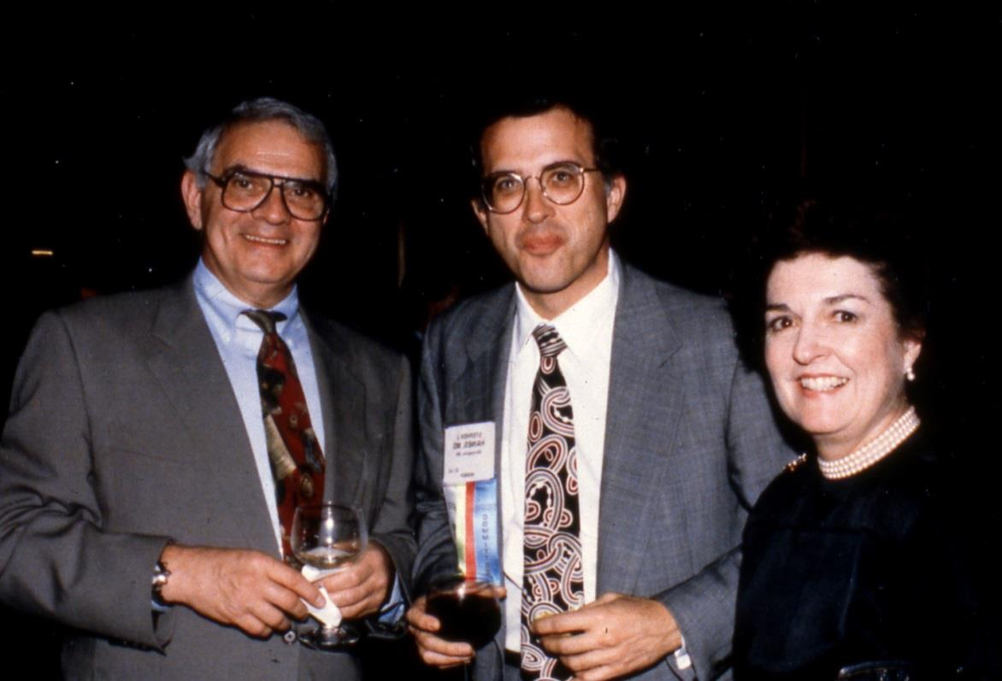
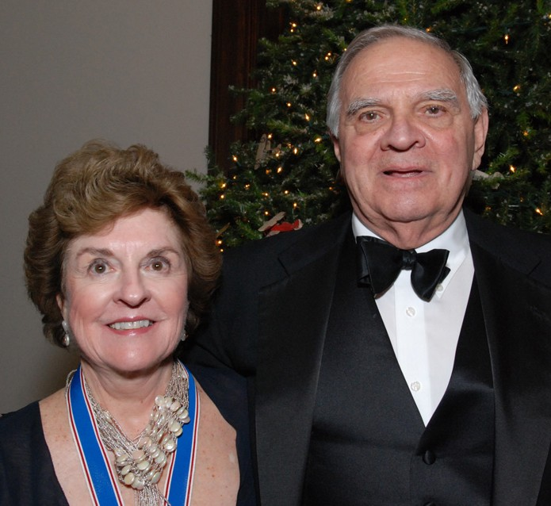
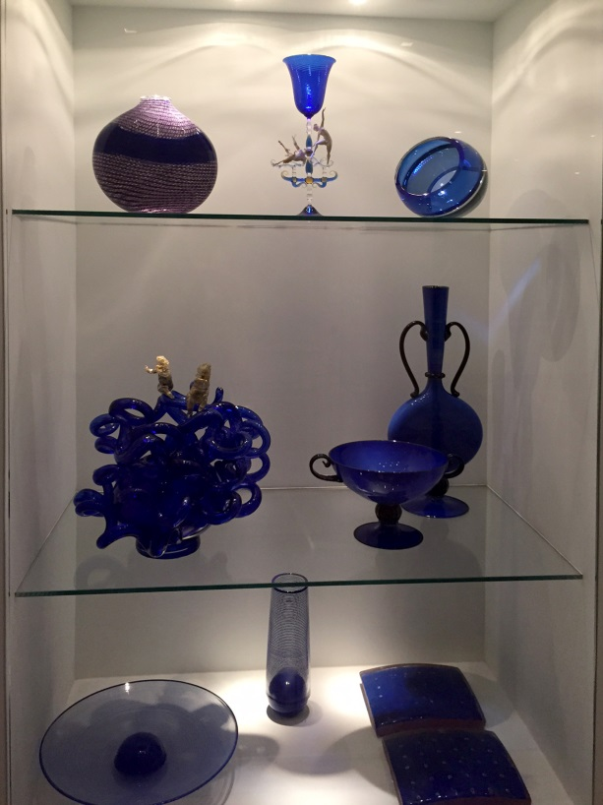
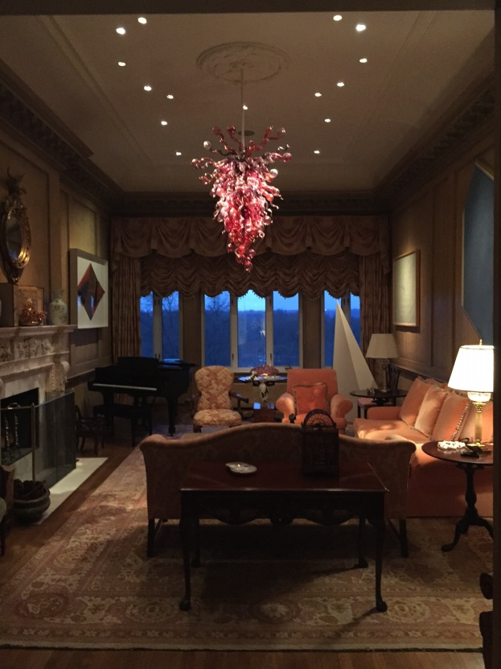

Slide 28
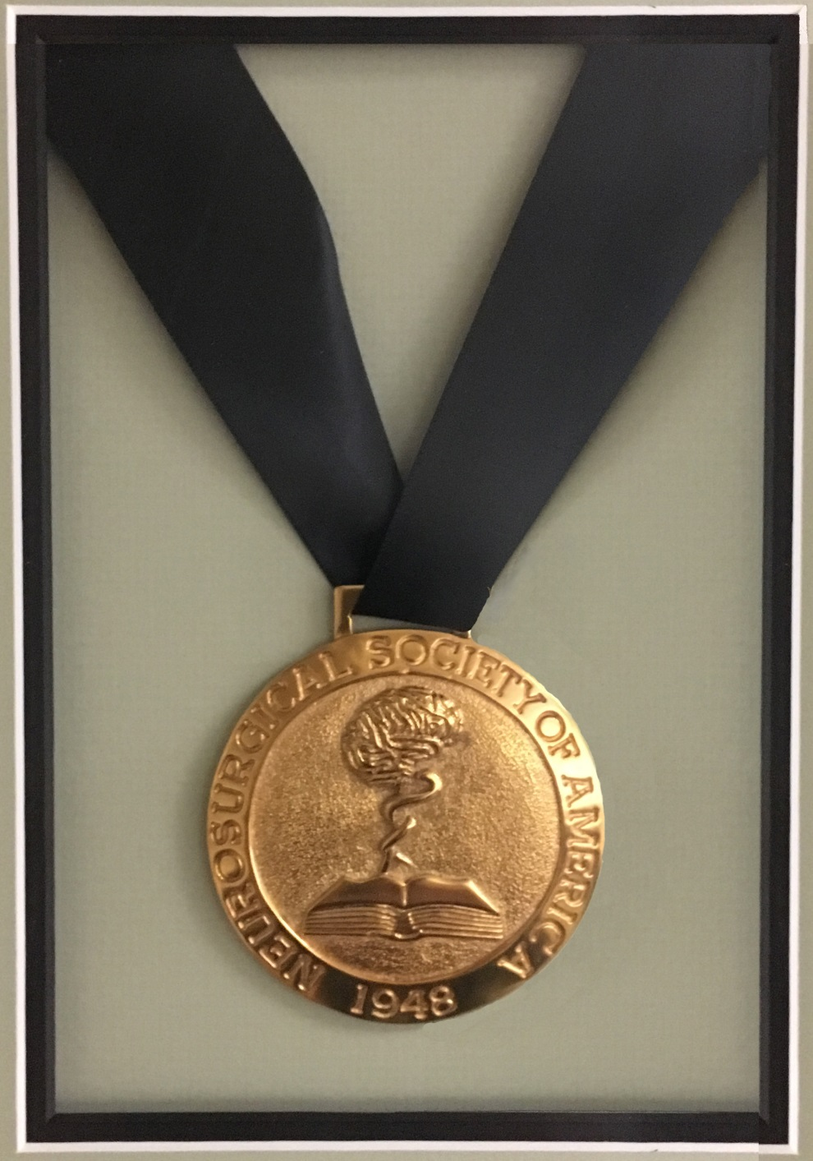
At the 64th Annual Meeting of this Society, on March 29, 2011, at the Mauna Lani Bay Hotel on the big island of Hawaii, President Nick Barbaro (who, incidentally, was a medical student in Pittsburgh) gave Peter this Society’s highest honor, the NSA Medal.

Slide 29
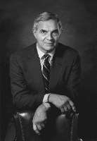
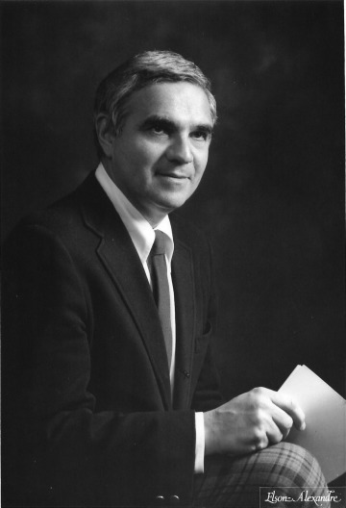
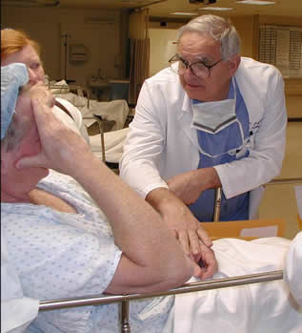
There are many images that capture the faces of Peter Jannetta.

Slide 30
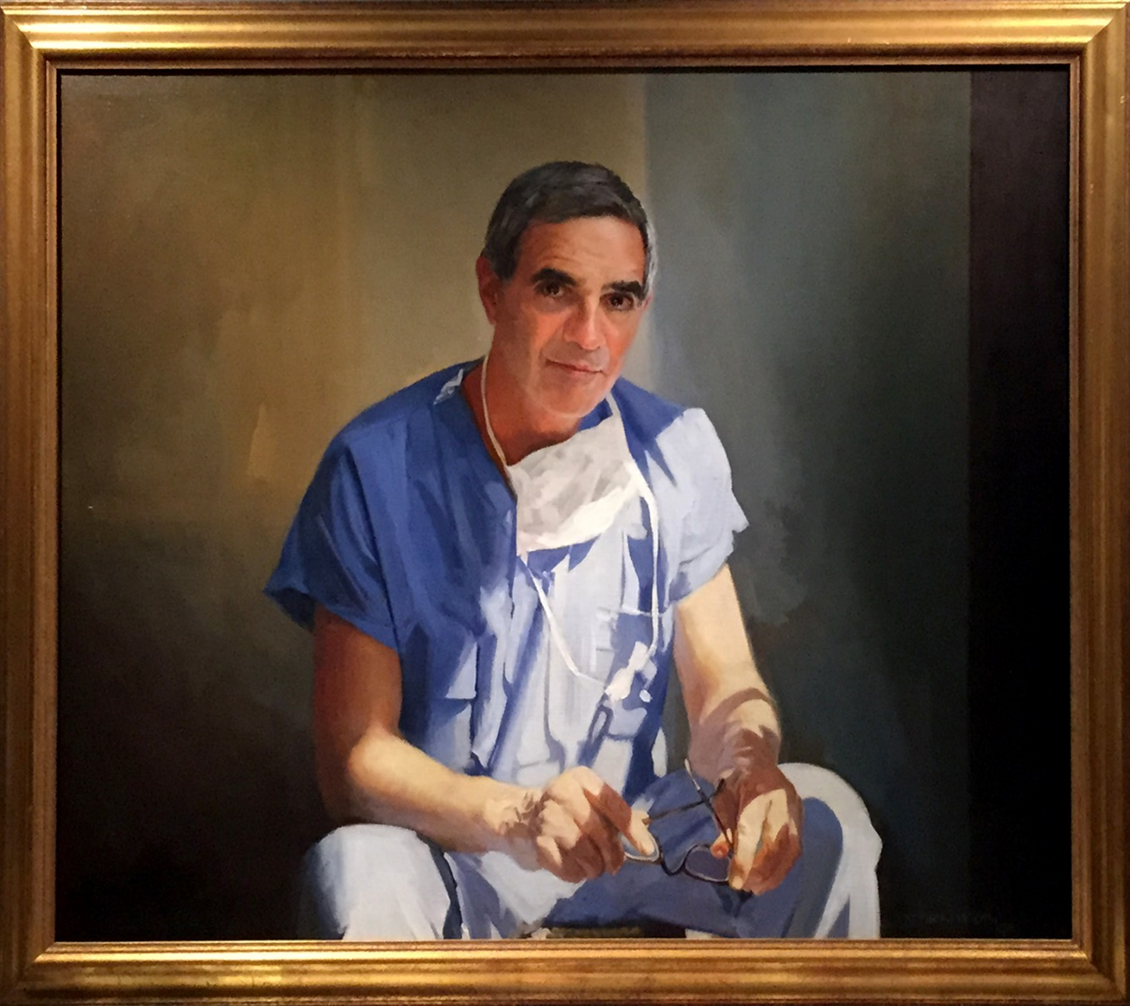
The one that hung in his study captures the intelligence, wisdom, the surgeon and a little bit of mischief of one of the giants of 20th Century Neurosurgery.

Slide 31
The NSA is honored by having chosen him for membership and for the honor of the NSA medal. We all miss him be cannot forget him.

